Slide 1
DR. B.B. HEGDE FIRST GRADE COLLEGE, KUNDAPURA (a Unit of coondapur education society ®)

Slide 2
MODERN MARKETING
V SEMESTER B.Com--BCMCMC312
:-Mrs. Avitha Correa
Assistant Professor in Commerce & Management

Slide 3
SYLLABUS:-
CHAPTER 1: Introduction to Marketing
CHAPTER II: Market Segmentation and Consumer Behaviour
CHAPTER III: Product Strategy
CHAPTER IV: Advertising and Sales Management
CHAPTER V: Marketing of Services
CHAPTER VI: Emerging Trends in Marketing

Slide 4
BOOKS FOR REFERENCE:
Marketing Management : Philip Kotler
Marketing Management : T.N. Chabra & S.K. Grover
Marketing Management : N Sontaki
Modern Marketing : B.S. Raman
Modern Marketing : Dr. S. Siddiqi
Modern Marketing : S.A. Sherlekar

Slide 5
Chapter 1
INTRODUCTION TO MARKETING

Slide 6
Marketing is a dominant branch of business management, it contributes to excel in business operations.
Marketing has been placed at the centre of business operations
Consumer satisfaction is accepted as business philosophy
Marketing can translate business philosophy into reality
Marketing plays critical role in deciding the success of business

Slide 7
Because of Marketing & Powerful Marketers, a nation develops socially & economically, Poor Marketing hinders economic development.

Slide 8
3 Basic Terms relating to Marketing:
MARKET, MARKETING & MARKETING MANAGEMENT
Different Meanings of Market:
Place where buying and selling of goods is held
Assembly of People
Area of Operation
Exchange of Commodities- buying and selling
Act of Buying & Selling
Course of Commercial Activities

Slide 9
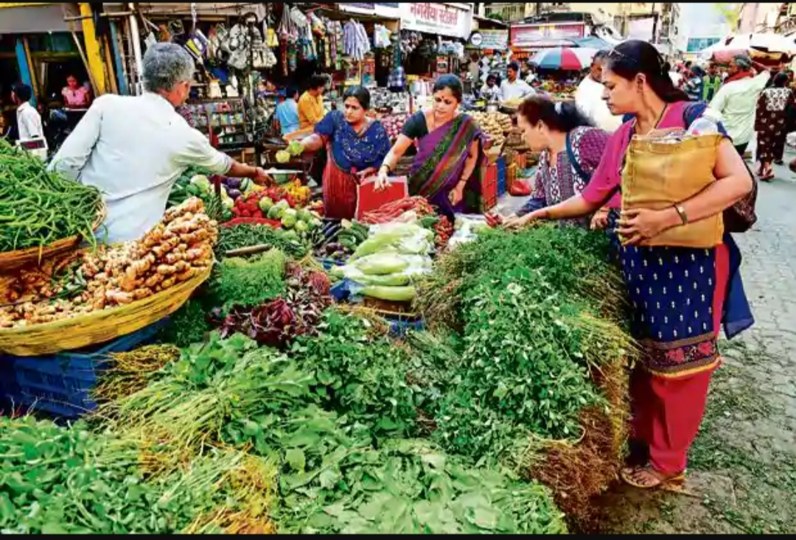

Slide 10
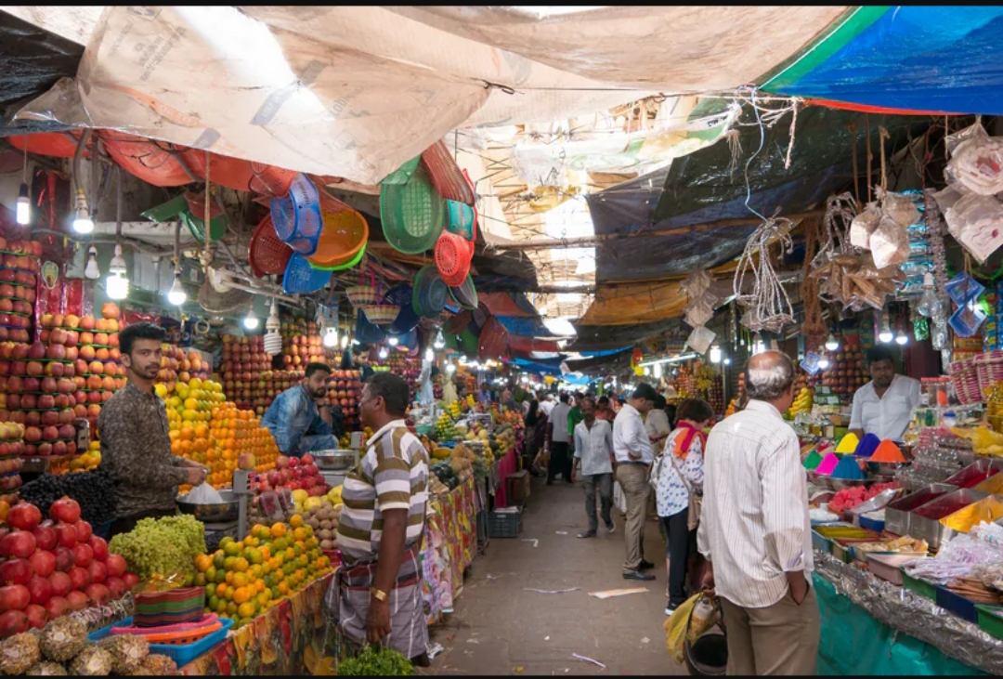

Slide 13
The term ‘Market’ has been derived from the Latin word
“Mercatus” = ‘to trade’. It also means: -to purchase and sell, place where business is conducted etc…
Definitions:
C.B Memoria: “A market is convenient meeting place for buyers and sellers to come together in order to conduct buying and selling”.

Slide 14
S. A. Sherlekar: “A market consists of the forces of demand (buyers) and supply (sellers) facilitating an exchange process between buyers & sellers”.
Philip Kotler: “A market consists of all potential customers sharing a particular need or want who might be willing and able to engage in exchange to satisfy this need or want”.

Slide 15
Essential Features / Characteristics of a Market:
The term ‘Market’ does not necessarily mean any particular place where goods are bought and sold. A place for the purpose of meeting of buyers and sellers is just a matter of convenience. So a market may mean either a particular place or the whole of any region.
The term ‘Market merely refers to the getting together of buyers & sellers of a particular commodity of any region, small or large.

Slide 16
It is true that, to constitute a market, there must be the getting together of the buyers & sellers or contact between the buyers & sellers. But there need not necessarily be personal or physical contact between the buyers & sellers. They need not necessarily meet each other face to face. The contact between the buyers & sellers may be established either in person or by mail, telephone, agents or any other means of communication.
The contact between buyers & sellers, established in person or through any other means, must be in relation to buying & selling of commodity.

Slide 17
5.There must be free intercourse (i.e. free or perfect competition) between the buyer & sellers of a particular commodity over any area so that a single price prevails for that commodity over the whole area at any given time.
6. No doubt, when a contract is entered into between a buyer & seller of a certain commodity, generally there is transfer of title to goods as well as delivery of goods from the seller to the buyer. But there need not necessarily be actual transfer of title to goods and physical delivery of goods bought & sold from the seller to the buyer to constitute a market.

Slide 21
Marketing: it consists of a large number of activities necessarily performed for a maximum consumer satisfaction.
Advanced IT, rapid means of transportation & communication, intense competition, consumer-oriented business strategies, spread of consumerism, business ethics, ecological issues, functioning of MNC’s.

Slide 22
Marketing is an exchange or a transaction intended to satisfy human needs or wants.
Marketing is a human activity directed at satisfying needs & wants.
It is concerned with the flow of goods from center’s of production to the center’s of consumption.

Slide 23
Marketing can be studied under two heads

Slide 26
Traditional marketing or old marketing concept

Slide 27
Traditional marketing is the process of flow of goods from the centres of production to the centres of consumption or use.
There are several difficulties and obstacles in this process.
A number of activities have to be undertaken and Form, Place, Time & Possession utilities have to be created.
First the goods have to be manufactured according to the requirements of the consumers- form utility is created.

Slide 28
Secondly goods have to be transported or moved from the centres of production to the centres of consumption- place utility has to be created.
Thirdly goods have to be made available to the ultimate consumers or users at the time when they are needed- time utility is created.
Time utility is created by storing in warehouses until they are needed.
Lastly ownership & possession of goods are to be transferred from the producers to the consumers- creation of possession utility.
It is created by selling the goods.

Slide 29
The various activities that help in the creation of Form, Place, Time & Possession Utilities and direct the flow of goods from the centres’ of production to the centres’ of consumption constitute the subject – matter of Traditional Marketing. This is the Traditional Marketing Concept

Slide 30
DEFINITIONS

Slide 31
In the words of Tousley, Clark & Clark, “Marketing consists of those efforts which effect transfer in ownership of goods and care for their physical distributions”.
According to Ralph S. Alexander and others, “Marketing is the performance of business activities that direct the flow of goods & services from producer to consumer or user”.

Slide 33
In the modern context, marketing is not considered as a mere physical process or set of activities connected with the exchange of goods. It is concerned with the creation of customers i.e., identifying the needs of the consumers and then organising the business accordingly to meet the needs of the consumers.
Modern marketing is “Consumer – Oriented”.

Slide 34
Modern Marketing came into existence due to :
There is an element of innovation in modern business
There has been a change in the objective or purpose of business
There has been a change in the attitude of the consumers in recent years

Slide 35
Definitions :
In the words of J.F. Pyle, “Marketing is that phase of business activity through which human wants are satisfied by the exchange of goods & services.”
According to Cundiff & Still, “Marketing is the business process by which products are matched with the market and through which transfer of ownership are effected.”

Slide 37
1. Modern Marketing is Consumer – Oriented: The objective of a business has changed in recent years. Earlier the main objective was profit maximisation. But today the objective is to create satisfied customers. Modern Marketing has become consumer oriented and consumer has become the king. The producers first ascertain what the consumers want, and then produce goods according to the needs of the consumers. It is the consumers who decide & determine what should be produced and marketed by a business.

Slide 38
2. Modern Marketing begins and ends with the consumers : Marketing begins with the information flowing from the consumers to the producers as to what they want and what should be produced, and ends with the goods desired by the consumers flowing from the producers to the consumers.
3. Modern Marketing precedes and succeeds production : All business organisations are fully convinced that marketing activities must begin, not after the goods are produced but far ahead of production.

Slide 39
Business organisations must determine, through studies and research before production, what the consumers want, how they want, when and where they want & at what price they want & then the production of goods must begin.
Marketing activities succeed production, in the sense that the marketing activities will continue until the goods produced in accordance with the needs of the consumers are moved to them.

Slide 40
4. Modern Marketing is the guiding element of business: It is the marketing potentialities and not the production resources that guide a
business today. It emphasizes the need for the integration and the successful performance of the various marketing activities involved from the time of the conception of the product idea until its profitable sale to the final consumers

Slide 41
Differences Between Traditional Marketing & Modern Marketing

Slide 43
TRADITIONAL MARKETING | MODERN MARKETING
1. It is a mere physical process connected with the exchange of goods. | 1. It is a philosophy of business concerned with the creation of satisfied customers. It is not just a physical process.
2. It is sales oriented. | 2. It is customer oriented.
3. It is concerned with the performance of activities necessary to secure the disrtribution and sale of goods which the producer has. | 3. It is concerned with the performance of activities necessary to secure the distribution and sale of goods as are needed by the consumers.
4. It focuses on seller’s needs. | 4. It focuses on consumer’s needs.

Slide 44
5. The selling efforts are company oriented. | 5. The selling efforts are market oriented.
6. It aims at profit through increased sales volume. | 6. It aims at profit through increased sales to the satisfaction of the consumers and profit to the sellers.
7. It aims at short term objectives, i.e. short term profits. | 7. It aims at long term objectives, i.e. long term profits.
8. It can be successful only in a country where there is shortage of goods leading to the existence of a seller’s market. It cannot be successful in a country where there is surplus leading to the existence of buyer’s market. | 8. It can be successful in a country where there is buyer’s market.

Slide 45
SIGNIFICANCE OR IMPORTANCE OF MARKETING

Slide 47
The importance or the benefits of marketing can be considered under two heads:
Benefits to the society in general
Benefits to the individual business firms

Slide 50
Benefits to the society In general
Marketing is a sum of several distinct activities that facilitate the flow of goods from the producers to the final consumers. The various marketing activities are undertaken by different categories of persons & each category of persons specialise in a distinct operation i.e., marketing stimulates division of labour & specialisation. This contributes to the satisfaction of consumer needs quickly, easily, efficiently and economically.

Slide 51
Marketing makes goods & services more useful to the society by creating place, time, & possession utilities i.e. by moving them to places where they are wanted, when they are wanted & by transferring them to those who want them.
Marketing implies the identification of the requirements of the consumers and the supply of only those goods and services which the consumers want. It helps the consumers to get what they want.
Efficient marketing reduces the cost of distribution. The reduction in the cost of distribution results in lower prices for the consumers.

Slide 52
Efficient marketing reduces full and complete flow of goods and services continuously from the centre’s of production to the centre’s of consumption. This contributes to the high level of economic activity.
Efficient marketing is the strong bridge between production & consumption. Marketing contributes to a healthy balance between production & consumption. This balance contributes to the avoidance of cyclical fluctuations like boom & depression & the production of economic stability.

Slide 53
Marketing involves a number of functions. Each function is performed by a large number of persons. That means, marketing provides gainful employment to millions of people.
Marketing contributes to increase in the incomes of the people by providing employment.
Efficient marketing contributes to the fullest utilisation of the available resources & ensures maximum output & supply to the society.
It integrates the various sectors of the economy, such as agriculture, mining, fishing, forestry & manufacturing.

Slide 54
It mobilises potential & untapped economic energy for economic development.
It can inspire innovators/entreprenuers to take up new activities. Eg: good marketing facilities for handloom goods, organic products, handicrafts & farm products have inspired & encouraged a large number of people of India to engage in these lines in recent years.
It has contributed to the emergence & growth of economy in countries of primitive economy, better marketing facilities have induced the old producers to produce more for sale in the market.

Slide 55
Marketing helps to raise the standard of living of the community.
Prof. Malcolm MC Nair, defines: “Marketing is the creation & delivery of standard of living to the society.”
Increase in employment & income
Continuous production & supply of goods
New & better quality goods
Reduction in the cost of distributions
Yesterday’s luxuries are today’s necessaries
Identifying the needs of the society

Slide 56
Benefits to the individual business firms
W. J. Stanton defines: “Marketing is the beating heart of many operations of the firms.”
Marketing helps the business to earn more profits. It provides many opportunities to the business firms to earn profits in the process of buying & selling of goods

Slide 57
Marketing is the ‘eyes & ears of a business’. It gives to the firm continuous market information i.e., information about the changes in the fashions, styles, habits, likes, dislikes, preferences etc. of the consumers & thereby adjust the production according to the changing conditions in the market.
It serves as the basis for decision making. Through the mechanism of marketing a business firm will be able to collect information as regards the needs of the consumers & take proper decision as to what to produce, how much to produce & where to produce.

Slide 58
Marketing converts potential demand into effective / actual demand.
It helps to expand the market for a product.
The process & the volume of production depends upon the successful performance of the marketing operations.
Marketing with its specialised functions performed by specialists, reduces the time involved in the task of exchange.
Marketing provides the working capital required by a firm, in the sense that it is the sale proceeds of goods that serve as the working capital of a concern.

Slide 59
Limitations of Marketing

Slide 60
High Cost of Marketing: The cost of marketing has become high in recent years. The benefits of marketing are available at unduly high cost. The cost of marketing is around 50% of the selling price of the product.
High costs of marketing are due to these causes:
High expectations of consumers: consumers want best quality products right at the door step because of modern life style

Slide 61
Inefficiency of marketers: All marketing organisations & people are not efficient. This increases the cost of marketing
Spread of consumers over a wide area: Consumers are spread over the nation. Cost of distribution results cost of marketing

Slide 63
To satisfy the needs and wants of the target market, the marketing manager has to take decisions on various marketing areas. The combination of such marketing areas is known as Marketing Mix
It is also called as Marketing Programme
Marketing mix is conditioned with two sets of variables:
i) the controllable factors / internal factors
ii) the uncontrollable factors / external forces

Slide 64
Controllable factors are those forces which are within the hold of the business firm. They include: Product, Price, Promotion, Place.
Uncontrollable forces refer to those forces which are not within the hold of the business firm. They include: Consumers’ behavioural forces, Traders behavioural forces, Competitors behavioural forces, Government behaviour / regulations.

Slide 65
The uncontrollable forces are not within the hold of the business firms, therefore the four controllable forces are mixed / blended / combined into a marketing plan or programme.
The mixing, blending or combining of the four controllable forces, the product, price, promotion & place is called marketing mix of the firm.

Slide 66
Definitions:
The word marketing mix was coined by Prof. Neil H Borden of Harvard Business School.
According to Prof. Neil H. Borden “Marketing mix consists of a list of the important elements or ingredients that make up marketing programme & a list of forces to which manager must adjust.”

Slide 67
R. S. Dawer: “Group of various policies used by producer to succeed in market can be said as marketing mix.”
Philip Kotler: “the set of controllable marketing variables that the firm blends to produce the response it wants in the target market.”

Slide 68
Four Components / Elements / Ingredients of Marketing Mix

Slide 69
Marketing Mix comprises of 4 elements.
They are:
These are popularly known as four P’s of Marketing Mix

Slide 71
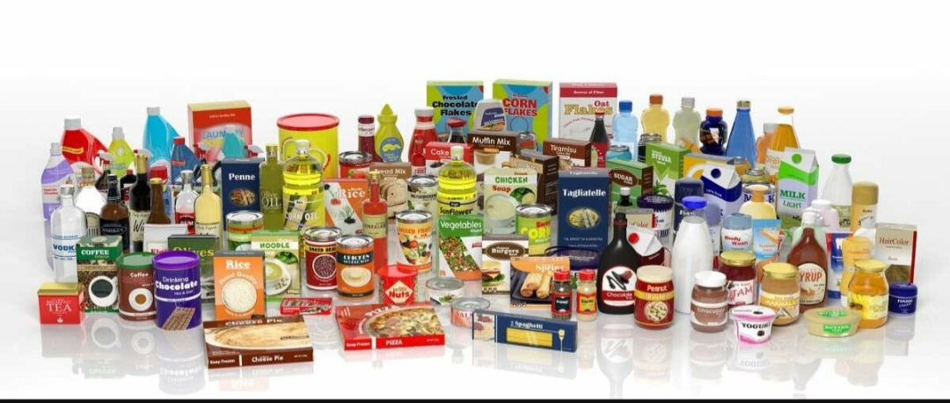
Four Elements of Marketing Mix:
Product: It covers the characteristics of the product, such as quality, durability, shape, design, utility etc., the product range, the package, branding & labeling and the warranty & service accompanying the product.

Slide 72
Price: It covers the pricing policy, basic prices, discounts and allowances, terms of credit allowed.

Slide 73
Promotion: It covers the various means of marketing communication such as advertising, personal selling or salesmanship, sales promotion, publicity & public relations designed to persuade the buyers to buy the product.

Slide 74
Place/Distribution: It covers the channels of distribution and the physical distribution including transportation, warehousing and storage, financing & handling the product.

Slide 75
Factors Affecting Marketing Mix:
There are certain uncontrollable forces which affect the marketing mix:
Consumers’ Behavioural Forces: Comprise the number of buyers, their motivation in buying, buying habits, living habits, buying power, the attitude towards the product, technological & socio-economic developments in the society.
Traders’ Behavioural Forces: Comprise the structure, motivation, attitudes & the practices of the traders.

Slide 76
c) Competitors’ Behavioural Forces: include the number of competitors, the size and strength of the competitive practices adopted by the competitors and their reactions to the actions of other firms.
d) Government Behaviour: includes Govt. regulations over products, quality control, pricing, restrictive & unfair trade practices, distribution system, advertising & sales promotion, competitive practices etc.

Slide 77
Essentials of an Effective Marketing Mix:
Marketing mix or plan is no doubt an effective tool or technique for ensuring effective and successful marketing. But the mere mixing of the four controllable forces into a marketing plan is not enough. The four controllable factors must be mixed in right proportion so as to result in an effective marketing mix. There should be an appropriate marketing mix.

Slide 78
As the marketing mix is affected by certain uncontrollable market forces, the marketing mix must be in tune with the uncontrollable market forces.
As each marketing mix is developed to satisfy the anticipated & perceived needs of an identified market within a given environment, when there are any variations in the environmental forces or market forces, the marketing mix also should be properly varied or adjusted in accordance with the changes in the environment. Then only a firm can get favourable response from the buyers & secure the planned sales volume.

Slide 79
MARKETING MANAGEMENT

Slide 80
Marketing Management signifies an important functional area of business management responsible for the flow of goods from the producers to the consumers. It is accountable for planning, organising, directing, coordinating, motivating & controlling the marketing activities.
Marketing Management has the responsibility for managing the process that culminates into exchanges. It consists of the making and implementing of the decisions necessary for the making of specific ideas, goods & services.

Slide 81
Definitions:
According to Philip Kotler, “ Marketing Management is the analysis, planning, implementation control of programmes designed to create, build, maintain mutually beneficial exchanges and relationships with target markets for the purpose of achieving organisational objectives.”
William J Stanton, “Marketing Management is the marketing concept in action.”

Slide 82
Features / characteristics / nature of marketing management
Marketing Management is one of the important functional areas of business management, which is concerned with marketing of goods and services.
Marketing is a social function. It requires constant interaction with the various groups of society, it influences the patterns of consumption & consumer attitudes.

Slide 83
3. Marketing is an integrative function. It integrates & combines the other business functions like production, finance, personnel etc., with a view to accomplish the organisational objectives.
4. Marketing management is a universal function. It has universality in the sense that it can be applied to both profit & non-profit motive organisations.
5. Marketing Management is goal oriented. It aims at satisfying the needs of customers by offering them the goods & services they want and generating profits for the enterprise.

Slide 84
6. Marketing mix, i.e. Product, Price, Promotion & Place is one of the important elements of Marketing Management.
7. Marketing Management rests on the notion of exchange, i.e. one party is willing to part with, and the other party is ready to accept, under some agreed consideration.
8. Marketing Management applies marketing concept not only to goods and services, but also to ideas.

Slide 85
Objectives of marketing management

Slide 86
Determination of Customers’ needs: The objective of marketing management is to identify & satisfy the customers’ needs. The firm or the manufacturer should ascertain the needs of the customer. It is after the decision taken about the customer’s needs, production is started.
Creation of Demand: The marketing management’s objective is to create demand through various means. A conscious attempt is made to find out the preferences & tastes of the consumers. Goods & services are produced to satisfy the needs of the consumers. Demand is also created by informing the customers the utility of various goods & services through advertisement.

Slide 87
Customer Satisfaction: The marketing manager must study the demands of the customers before offering them any goods or services. Selling the goods or services is not that important as the satisfaction of the customer’s needs. Modern Marketing is customer oriented. It begins and ends with the customer.
Market Share: Every business aims at increasing its market share, the ratio of its sales to the total sales in the economy.

Slide 88
Generation of Profits: The marketing department is the only department which generates revenue for the business. Sufficient profits must be earned as a result of sale of want satisfying products. If the firm is not earning profits, it will not be able to survive in the market. Profits are also needed for the growth & diversification of the firm.
Creation of Goodwill & Public Image: The marketing department provides quality products to customers at reasonable prices & thus creates its impact on the consumers. The marketing manager attempts to raise the goodwill of the business by initiating image building activities such as sales promotion, publicity & advertisements, high quality reasonable price, convenient distribution outlets etc.

Slide 89
Contribution to National Development: Marketing Management contributes to fuller & wiser utilisation of national resources & increase in employment facilities & economic growth.
Raising the Standard of Living of the people: By ensuring that many varieties of goods are available for consumption, marketing management aims at raising the standard of living of the community.

Slide 90
Marketing management process
Marketing Management is a process because it manages the marketing plan, policies & programmes keeping in view the broad objectives of accomplishing the organsisational goals and the society’s expectations.
Philip Kotler defines (steps involved in Marketing Management Process):

Slide 91
Analysing Marketing Opportunities
Researching & Selecting Target Markets
Designing Marketing Strategies
Planning Marketing Programmes
Organising, Implementing & Controlling Marketing efforts

Slide 93
Analysing the Marketing Opportunities: No Company can depend on its markets & products forever. Every Company must identify new marketing opportunities. New opportunities can be searched casually or systematically. It can be searched casually by simply keeping the eyes and ears open in the changing environment & systematically by reading newspapers, attending trade shows, examining competitor’s products & collecting market information.

Slide 94
II. Researching & Selecting Target Markets: Target market means well-defined set of customers whose needs the firm plans to satisfy. As there are different types of customers with different kinds of needs, it becomes necessary for an enterprise to undertake the study of the total market & select those segments of the market which it can serve well than its competitors. So, there arises the need for selecting target markets.

Slide 95
III. Designing Marketing Strategies: After identifying the marketing options, a strategic plan is developed to pursue the identified options. An analysis is done & best available option is chosen, a plan or strategy is made for that option. At this step elaborated tactical decisions are made for the controllable forces of the marketing mix. It includes decisions related to product development, product pricing, product promotion & product distribution.

Slide 96
IV. Planning Marketing Programmes: It is not enough to formulate only the board of strategies by which the business expects to achieve its marketing objective but also plan the supporting marketing mix programmes. Decisions have to be taken regarding the features, packaging, branding, servicing policies etc.
V. Organising, Implementing & Controlling Marketing Efforts: It means organising the marketing resources & implanting & controlling the marketing plan. The company requires to design a marketing organisation that will be able to degenerate the marketing plan up to work. It is a system which ensures that marketing activities are performed as per the marketing objectives and plans.

Slide 98
It is described as the philosophy the firm holds towards the market and the ways of doing business with the consumers.

Slide 99
The exchange concept:

Slide 100
Marketing can be described as an exchange. The exchange concept of marketing, holds that the central idea in marketing is exchange i.e., exchange of a product between the seller & the buyer. There are firms who operate with the belief that business / marketing is simply a matter of giving a product to someone in exchange of some money change hands.
To view marketing as a mere exchange is the most short-sighted view of the total process involved. Marketing is much broader than exchange. Several other important aspects of marketing such as concern for the customer, generation of value, creative selling etc. are involved in marketing. They are all completely overshadowed in the exchange concept. Exchange Concept covers the physical aspect & the price mechanism involved in marketing.

Slide 101
The production concept:

Slide 102
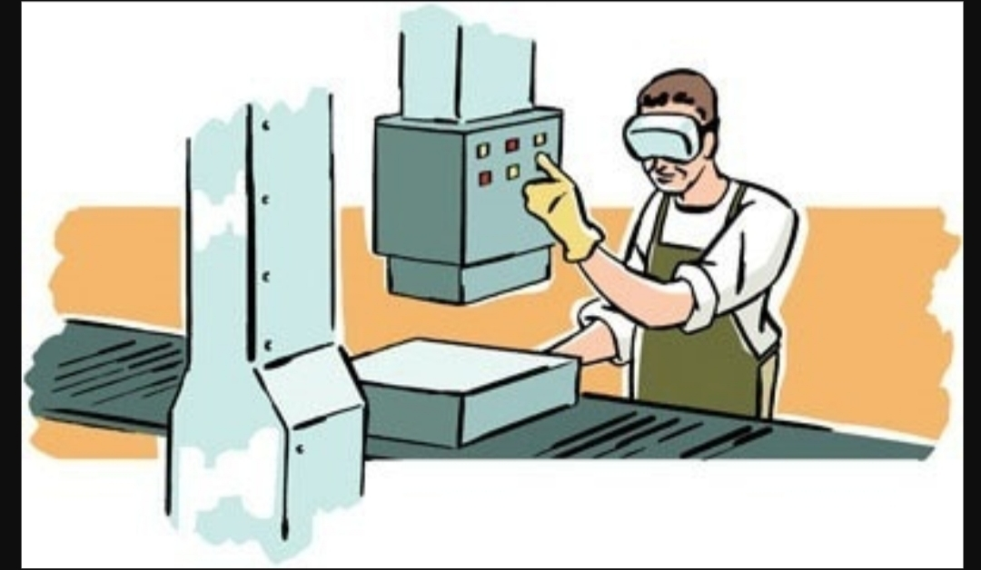
Firms with whom production dominates the thinking process. Firms believe that business can be managed by maximisation of production & lower unit cost. This is known as the Production Concept.
It says that consumers, as a rule, would support products that are produced in great volume at a low unit cost & sold at a low price.

Slide 103
In such organisations, production will dominate the thinking, and marketing is a mere appendage (sub-unit) to production. They assume that the lower cost & price will automatically bring all the customers at their doors.
But in actual practice, it doesn’t happen. Customers go by variety of considerations in their purchases, besides price.

Slide 104
As a result, the production concept fails to serve as the right business philosophy for an enterprise. Companies having a production orientation think that customers exist to buy the firm’s products rather than firms exist to serve customers. They make whatever products are easy to make & then try to sell them. Great brands cannot be built on the bases of production volume & low unit cost, consumers buy goods which satisfy their wants even at high prices. This concept doesn’t give importance to quality of the products. Customers are not given personal attention in Production Concept.

Slide 105
Utility: It is suitable for mass consumption products like food articles, fertilizers, stationery etc.

Slide 106
The product concept:

Slide 107
In the product concept, product excellence is the supreme thing. Management firmly believes that if the product has superb features, quality & performance, customer response is bound to be favourable and all promotion efforts are needless. The product concept seeks to win markets through product excellence, improved products, new products & ideally designed and engineered products.

Slide 108
Companies spend their time & money on Research & Development & bring out many new products of good quality & performance & improving them. Firms assume that consumers would automatically vote for products of high quality.
Failure:- These firms too fail to achieve great marketing success despite their turning out a quality product as they fail to find out what the consumers actually need and what they will gladly accept. Over - emphasis on product excellence may lead a marketer to ignore many other aspects of customer needs and desires.

Slide 109
Consumers for whom the product is meant may be ignored. It is marketing myopia or short-sightedness. Product oriented companies often design their products with little or no customer input.
Utility:- This concept is practiced in areas like fashionable & expensive readymade garments, shoes, watches, restaurants & hotels, clinics, transport services, courier services etc.
It is more adopted in service oriented or non-product organisations.

Slide 110
The selling concept:

Slide 111
This concept holds that consumers, if left alone, will ordinarily not buy enough of the organisation’s products. The organisation must therefore undertake an aggressive selling and promotion effort.
Firms that are oriented heavily towards selling, practice this concept. These firms believe that marketing’s major concern is to aggressively push the products. High power personal selling, heavy advertising, large-scale sales promotion & heavy price discounts are the tools used by the sales concept.

Slide 112
“Push the product somehow to the customer” is its buzzword.
Product does not sell itself, it has to be sold. Most firms practice the selling concept when they have over capacity. Their aim is to sell what they make rather than make what the market wants.
Failure:- this concept too suffers from severe inadequacies. Because the company aggressively promotes and pushes its products, it cannot expect its products to get picked automatically by the customers. Companies practicing the sales concept assume that selling is same as marketing. But, in reality there is a great difference between selling & marketing.

Slide 113
Utility: -Selling concept is practiced more aggressively for those goods that buyers normally do not think of buying. Such as insurance products, products which have low demand, technical products, automobiles, books etc.
This concept is also practiced in the non-profit area by fund raisers, college admissions & political parties.

Slide 114
The marketing concept:

Slide 115
When a marketer adopts a market oriented business philosophy, the guiding principle becomes “it is more effective to make what customer wants to buy than to sell them what a marketer wants to make or sell.” Thus, all the company activities rotate around the primary goal of satisfying customer needs. The marketing concept is defined as a customer oriented philosophy integrated to serve customer better than competitors and there by ensure sustained growth & prosperity.

Slide 116
The essence of marketing concept is that the customer and not the product. Marketing plans, policies & programmes are formulated to serve efficiently the customer demand.
The themes of Marketing Concept are:
“The Customer is the boss”
“We are satisfied if our customers are satisfied”
“Have it your way”
“Have the customer and not the product”

Slide 117
Utility:- Long term success is assured to an organisation, marketing risks can be reduced, helps the firm to move more quickly, it assures effective marketing & achievement of organisational goals.
Criticisms:- The business firms just talk about the marketing concept, but do not practice it in the real sense.
It is difficult to keep pace with the changing consumer characteristics & environmental changes & to produce or offer services which would bring satisfaction to consumers.
Even if there is marketing, consumerism is more active, consumerism is a shame to marketing.

Slide 118
While meeting the needs & wants, organisation’s have neglected society’s needs (Eg: A fast food industry provides tasty but non-nutritious food, product is packed and there is wastage in packing materials. It satisfies the consumer wants but by hurting consumers health & creating environmental problems.)

Slide 119
the societal marketing concept:

Slide 120
It is the broadening of Marketing Concept. It is described as marketing concept expanded with societal orientation where by a company can satisfy its customers and at the same time fulfill its responsibility to society.
In order to be safe in future, firms must follow operating practices that advance the economic & social conditions in the communities in which they operate.

Slide 121
The Societal Marketing Concept holds that the organisation’s task is to determine the needs, wants and interests of target markets and to deliver the desired satisfactions more effectively and efficiently than competitors in a way that preserves or enhances the consumer’s and the society’s well-being.

Slide 122
A number of companies have achieved notable sales & profit gains through adopting & practicing the societal marketing concept.
This concept is based on following premises:
The marketer has to fulfill the customer demand and also to contribute to enrichment or quality of life
The marketer shall not offer a product to consumers if it is not in the best interest of consumers

Slide 123
c. Marketer will offer long-run consumer and public welfare
The marketing plans & programmes shall duly consider consumer-citizen wants
The societal marketing concept calls upon marketers to balance 3 considerations in setting their marketing policies, namely: company profits, consumer’s want satisfaction and public interest.

Slide 124
Utility:- A societal marketing concept is of immense value. It is also called as Human Marketing Concept. It is helpful in creating an intelligent consumption pattern, serving ecological needs & helping the industry to grow. It serves the business as well as the society as a whole.

Slide 125
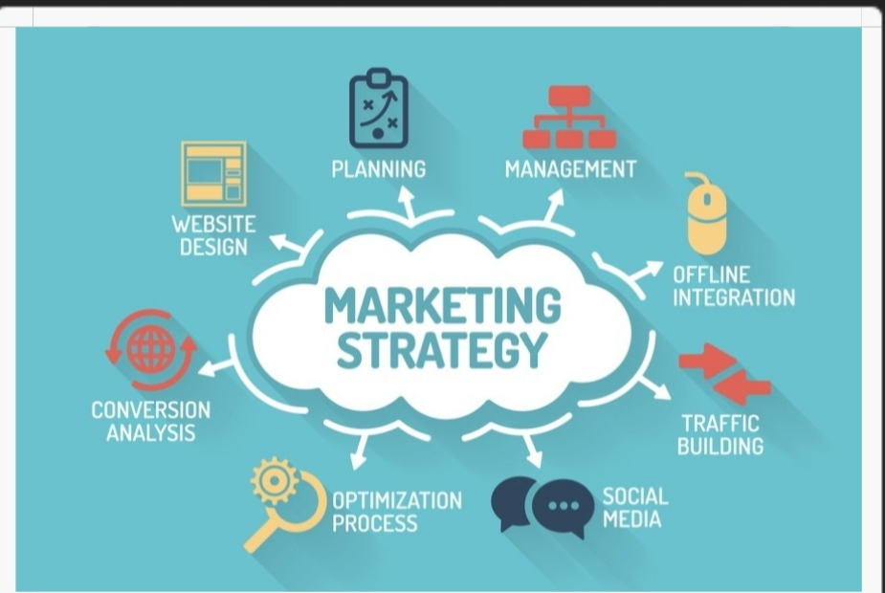
Development of marketing strategy

Slide 126
Marketing Strategy: It is the total and unbeatable instrument or plan shaped and designed specifically for attaining the marketing objectives of a firm.
Marketing Strategy provides us the grand design for reaching the marketing mission and objectives.

Slide 127
Definitions:-
“Strategy is the all-important part of marketing. The one time planning decision- the most crucial decision that determines what business the company is in and the general strategy, it will follow may be more important than has ever realised.” – Jerome Mc. Carthy.
Development of marketing strategy is a process that requires analysis of large amount of information.

Slide 128
Superior Solutions For Marketing Strategy:
Create project & process that enables company teams to implement marketing programme consistently.
Customise the scope & process steps of some projects to accommodate unique requirements and unforeseen situations.
Refine best practices based on previous experience and apply them to future projects.
Co-ordinate product launches among many internal organisations & external vendors, partners etc., which are often widely dispersed.

Slide 129
v. Collaborate on the creation of strategy documents and plans.
Attach reference materials & project specific documents to work steps for access by team members at the time of need.
Deliver the knowledge and tools needed to perform each task correctly at the appropriate time.

Slide 130
Competitive Marketing Strategy (CMS)
Competitive Marketing Strategy is long-term action plan that is devised to help a company gain a competitive advantage over its rivals. This type of strategy is often used in advertising campaigns by somehow discrediting competitive products or services. It is essential to companies competing in markets that are heavily saturated with alternatives for consumers.

Slide 131
Objectives:
Build Marketing Strategy: The marketing objective in a build marketing strategy is to increase sales and market shares. It is expansion of marketing and establishing competitive position in the market to increase their market share in order to become stars.

Slide 132
Hold Marketing Strategy: The marketing objective in a hold marketing strategy is to maintain the market share and maintain the products.
Harvest Marketing Strategy: The marketing objective here is to maximise profit while sales and market share are falling. To increase short term cash flow by reducing costs at a faster rate.

Slide 133
Divest Marketing Strategy: The marketing objective here is to drop or sell the product out of its entire product portfolio. It is liquidating the business, because resources can be better utilised elsewhere.
Niche Marketing Strategy: Here the objective is to touch by the other competitor. Strong competitor dominating major segments. The objective is to think small and in an attractive condition, small budget strong competitors dominating major segments for profitable operations.

Slide 134
Steps for the development of competitive marketing strategy:
Reducing Competition: This implies acquisition of smaller or weaker units, which are in competition
Joining Competition: This is another way of mitigating competition. It implies entering into joint venture with competing firms
Pre-empting Competition: This is a pro-acting approach. It is very effective when it is backed by competitive analysis

Slide 135
Competitive Marketing Strategy should be such that it will give sustainable competitive advantage. One has to be therefore productive & quick in one’s responses and one should be willing to invest in long-term projects.
d) Creating Barriers: This implies forbidding others from entering into the lane, based on strong financial and physical power. Many companies spend heavily barring others to think of such exchange extravaganza.
e) Differentiating the products: It plays to differentiate the products, one must not hesitate to differ one’s own product with a new to provide better value for money paid by the customer. It is not only ideal but practical.

Slide 136
f) Improving the speed response: The competitive edge can be further strengthened by improving the speed of response.
g) Diversity from regular activities: Instead of moving in the same line of activities, one should move out of it. That is, a firm should diverse out of focus activities. This makes available much wanted scarce resources in the focused activities.
h) Improving Efficiency: There is a close alliance between improving efficiency and the competitive edge. This helps the marketer to distinguish his products through reduced cycle of line & reduced cost.
***************

